Slide 1

Cybersecurity and Game Theory
COMS6998 sec:12 | The Economics of Cybersecurity
March 26, 2024

Slide 2
What is a “Game”?

Slide 3
What is a “Game”?
Everyday usage:
Typically some kind of competition
Usually more than one player
Can involve luck
Can involve strategy
Can involve skill
Usually for fun

Slide 4
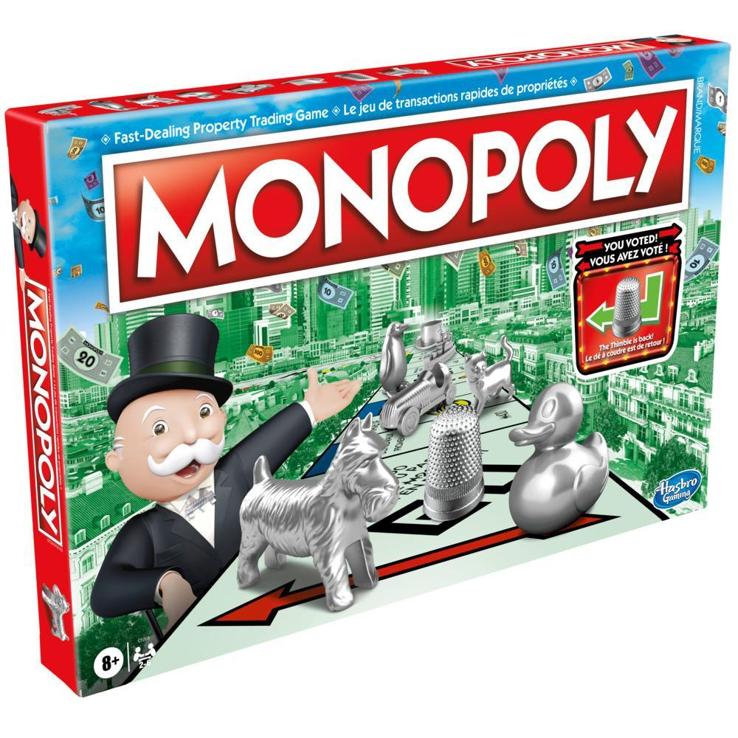
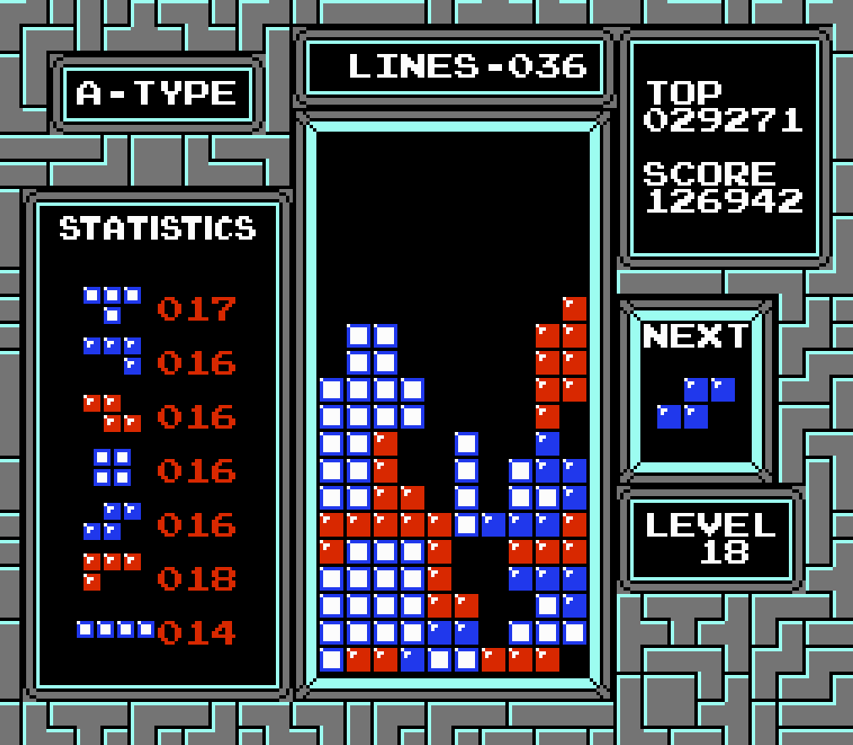


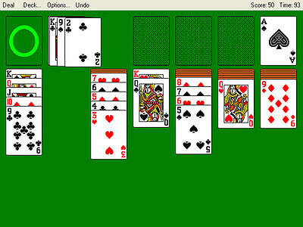
What is a “Game”?
Everyday usage:
Typically some kind of competition
Usually more than one player
Can involve luck
Can involve strategy
Can involve skill
Usually for fun

Slide 5
What is a “Game”?
Everyday usage:
Typically some kind of competition
Usually more than one player
Can involve luck
Can involve strategy
Can involve skill
Usually for fun
In Game Theory:
A mathematical description of a competition
2+ players (1-player games = decision theory)
Can involve “luck” (i.e. nondeterminism)
Strategy is the central focus of game theory
Not really about skill (unless skill = choosing best strategy!)
Always fun (for us, not always the players)

Slide 6
What is a “Game”?
In Game Theory:
A mathematical description of a competition
2+ players (1-player games = decision theory)
Can involve “luck” (i.e. nondeterminism)
Strategy is the central focus of game theory
Not really about skill (unless skill = choosing best strategy!)
Always fun (for us, not always the players)

Slide 7
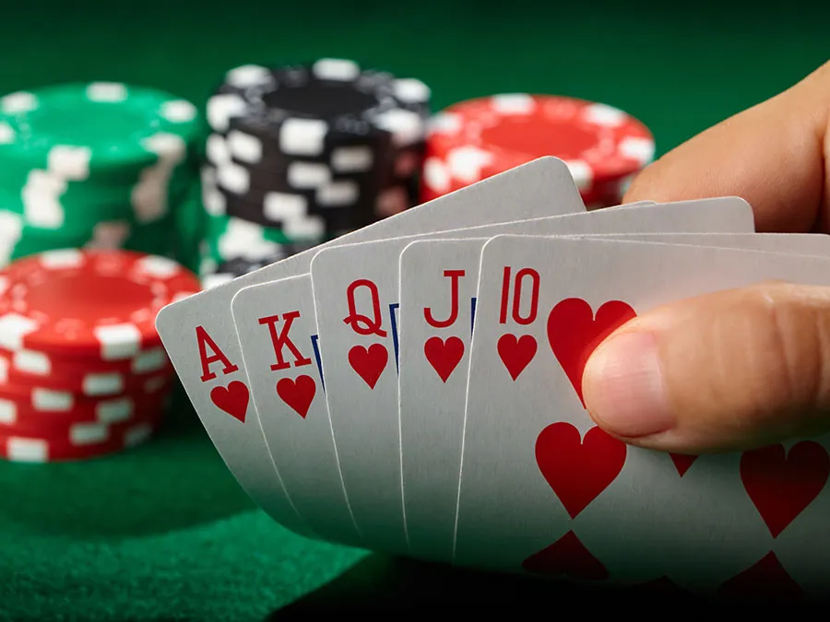
Types of Games
Two-player
Multi-player

Slide 8
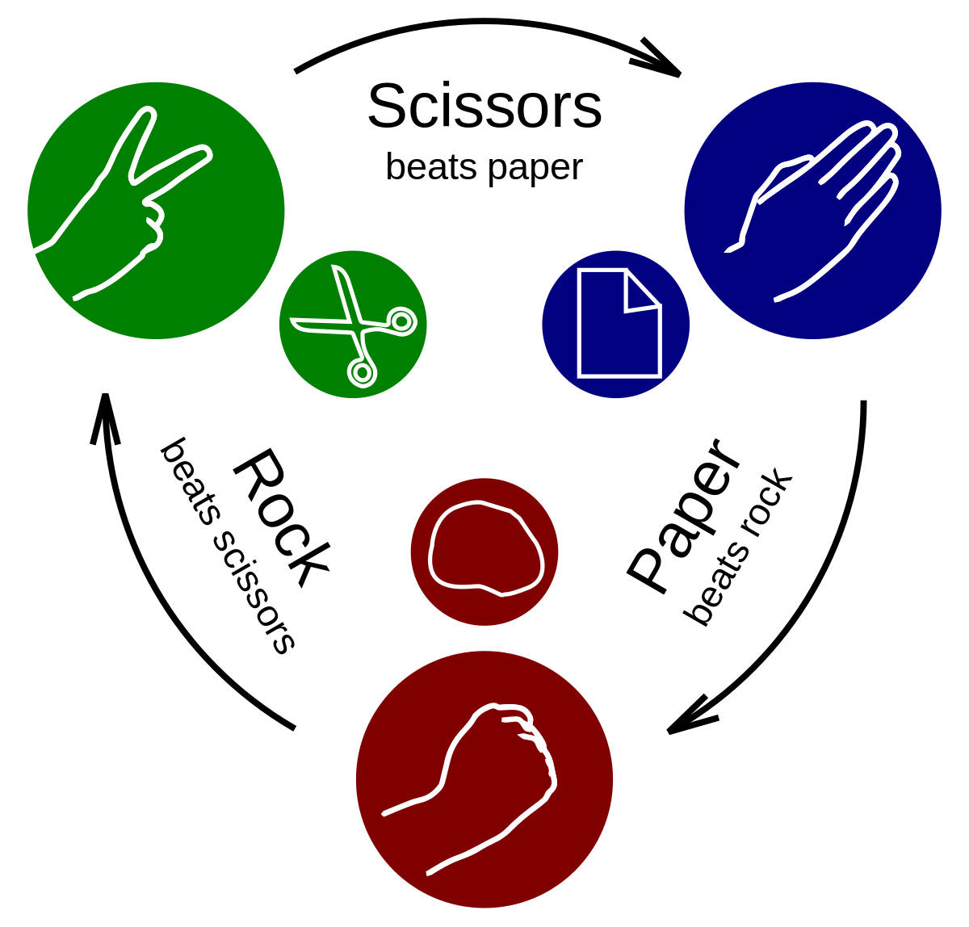
Types of Games
Simultaneous
Sequential

Slide 9
Types of Games
One shot
Iterated

Slide 10
Types of Games
Perfect information
Imperfect information

Slide 11
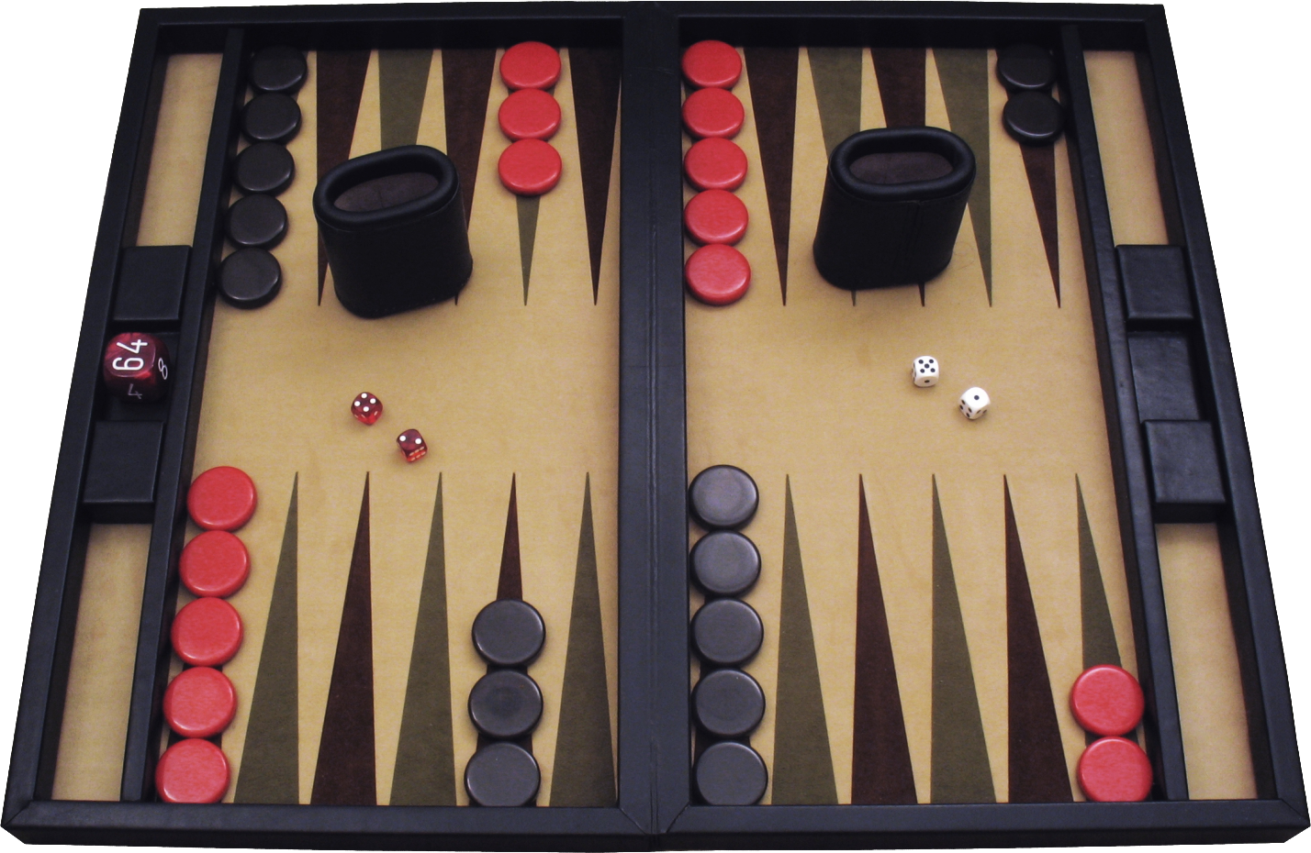
Types of Games
Deterministic
Non-deterministic
Notes:
Both perfect information

Slide 12

Types of Games
Finite strategies
Infinite strategies*
*if $ ∈ ℝ

Slide 13
How are games expressed mathematically?
Definition of a “Normal-form” game:
A set of players P = {1, 2, … , n}
Each player p_{i} has a set of available actions a_{i} = {1,2, … , k}
We can represent the actions of all n players as A = (a₁, a₂, … a_{n})
For group of actions, each player has a utility or payoff function u_{i}(A) → ℝ
We can represent the payoff functions of all n players an U = (u₁, u₂, … u_{n})
A normal-form game is defined as the tuple (P, A, U)

Slide 14
Other assumptions
Games are inherited (players do not choose the rules)
Players are generally assumed to be “perfect players” (i.e. perfectly rational)
“Perfectly rational” = “Always pick the strategy that maximizes utility”
In combinatorics games, we often assume that players have infinite compute powers

Slide 15
Example: Rock Paper Scissors
P = {player1, player2}
a₁ = a₂ = {rock, paper, scissors}, A = a₁ ✕ a₂
Payoff matrix U: A → (ℝ, ℝ)
 | Player2
Player1 |  | Rock | Paper | Scissors
 | Rock | Player1 ← 0 Player2 ← 0 | Player1 ← -1 Player2 ← 1 | Player1 ← 1 Player2 ← -1
 | Paper | Player1 ← 1 Player2 ← -1 | Player1 ← 0 Player2 ← 0 | Player1 ← -1 Player2 ← 1
 | Scissors | Player1 ← -1 Player2 ← 1 | Player1 ← 1 Player2 ← -1 | Player1 ← 0 Player2 ← 0
Notes:
“Where did the +1 and -1 come from? That’s not a part of rock paper scissors as I know it!”
I’ve chosen to model a “win” as a 1 and a “lose” and a -1. Tie is 0
The exact values don’t matter. What matters is the ordering.
Remember from our discussion on basic microeconomics? We can model people's’ decisions as having an effect on utility, and make the assumption that players are going to try to maximize their utility.
So it doesn’t matter if I’d chosen to represent a win as a 1 or a 100, because either way this representation captures how players play rock paper scissors.
From a game theory perspective, this is not a very interesting game. Why? Because there’s essentially no element of strategy. The only strategy is “pick one at random and hope for the best”
Maybe if you turn this into an iterated game, or are playing against someone you know well, maybe you can try to do some predictions based on past behavior. But that’s a different game.
In its most basic form, the rock paper scissors is pretty boring. Which is why we don’t play it for fun.

Slide 16
The Prisoner’s Dilemma
P = {prisoner1, prisoner2}
a₁ = a₂ = {cooperate, defect}, A = a₁ ✕ a₂
Payoff matrix U: A → (ℝ, ℝ)
 | Prisoner 2
Prisoner 1 |  | Cooperate | Defect
 | Cooperate | Player1 ← -1 Player2 ← -1 | Player1 ← -3 Player2 ← 0
 | Defect | Player1 ← 0 Player2 ← -3 | Player1 ← -2 Player2 ← -2
Notes:
What will be each player’s strategy? Recall that all players are trying to maximize their own utility.

Slide 17
The Prisoner’s Dilemma
What type of game is this?
P = {prisoner1, prisoner2}
a₁ = a₂ = {cooperate, defect}, A = a₁ ✕ a₂
Payoff matrix U: A → (ℝ, ℝ)
One shot | or | Iterated?
Simultaneous | or | Sequential?
Deterministic | or | Non- Deterministic?
Perfect information | or | Imperfect information?
Finite | or | Infinite?
2 player | or | Multiplayer?
 | Prisoner 2
Prisoner 1 |  | Cooperate | Defect
 | Cooperate | Player1 ← -1 Player2 ← -1 | Player1 ← -3 Player2 ← 0
 | Defect | Player1 ← 0 Player2 ← -3 | Player1 ← -2 Player2 ← -2
Notes:
What will be each player’s strategy? Recall that all players are trying to maximize their own utility.

Slide 18
The Prisoner’s Dilemma
What type of game is this?
P = {prisoner1, prisoner2}
a₁ = a₂ = {cooperate, defect}, A = a₁ ✕ a₂
Payoff matrix U: A → (ℝ, ℝ)
One shot | or | Iterated?
Simultaneous | or | Sequential?
Deterministic | or | Non- Deterministic?
Perfect information | or | Imperfect information?
Finite | or | Infinite?
2 player | or | Multiplayer?
 | Prisoner 2
Prisoner 1 |  | Cooperate | Defect
 | Cooperate | Player1 ← -1 Player2 ← -1 | Player1 ← -3 Player2 ← 0
 | Defect | Player1 ← 0 Player2 ← -3 | Player1 ← -2 Player2 ← -2
Notes:
What will be each player’s strategy? Recall that all players are trying to maximize their own utility.

Slide 19
The Prisoner’s Dilemma
What type of game is this?
P = {prisoner1, prisoner2}
a₁ = a₂ = {cooperate, defect}, A = a₁ ✕ a₂
Payoff matrix U: A → (ℝ, ℝ)
One shot | or | Iterated?
Simultaneous | or | Sequential?
Deterministic | or | Non- Deterministic?
Perfect information | or | Imperfect information?
Finite | or | Infinite?
2 player | or | Multiplayer?
 | Prisoner 2
Prisoner 1 |  | Cooperate | Defect
 | Cooperate | Player1 ← -1 Player2 ← -1 | Player1 ← -3 Player2 ← 0
 | Defect | Player1 ← 0 Player2 ← -3 | Player1 ← -2 Player2 ← -2
Notes:
What will be each player’s strategy? Recall that all players are trying to maximize their own utility.

Slide 20
The Prisoner’s Dilemma
What type of game is this?
P = {prisoner1, prisoner2}
a₁ = a₂ = {cooperate, defect}, A = a₁ ✕ a₂
Payoff matrix U: A → (ℝ, ℝ)
One shot | or | Iterated?
Simultaneous | or | Sequential?
Deterministic | or | Non- Deterministic?
Perfect information | or | Imperfect information?
Finite | or | Infinite?
2 player | or | Multiplayer?
 | Prisoner 2
Prisoner 1 |  | Cooperate | Defect
 | Cooperate | Player1 ← -1 Player2 ← -1 | Player1 ← -3 Player2 ← 0
 | Defect | Player1 ← 0 Player2 ← -3 | Player1 ← -2 Player2 ← -2
Notes:
What will be each player’s strategy? Recall that all players are trying to maximize their own utility.

Slide 21
The Prisoner’s Dilemma
What type of game is this?
P = {prisoner1, prisoner2}
a₁ = a₂ = {cooperate, defect}, A = a₁ ✕ a₂
Payoff matrix U: A → (ℝ, ℝ)
One shot | or | Iterated?
Simultaneous | or | Sequential?
Deterministic | or | Non- Deterministic?
Perfect information | or | Imperfect information?
Finite | or | Infinite?
2 player | or | Multiplayer?
 | Prisoner 2
Prisoner 1 |  | Cooperate | Defect
 | Cooperate | Player1 ← -1 Player2 ← -1 | Player1 ← -3 Player2 ← 0
 | Defect | Player1 ← 0 Player2 ← -3 | Player1 ← -2 Player2 ← -2
Notes:
What will be each player’s strategy? Recall that all players are trying to maximize their own utility.

Slide 22
The Prisoner’s Dilemma
What type of game is this?
P = {prisoner1, prisoner2}
a₁ = a₂ = {cooperate, defect}, A = a₁ ✕ a₂
Payoff matrix U: A → (ℝ, ℝ)
One shot | or | Iterated?
Simultaneous | or | Sequential?
Deterministic | or | Non- Deterministic?
Perfect information | or | Imperfect information?
Finite | or | Infinite?
2 player | or | Multiplayer?
 | Prisoner 2
Prisoner 1 |  | Cooperate | Defect
 | Cooperate | Player1 ← -1 Player2 ← -1 | Player1 ← -3 Player2 ← 0
 | Defect | Player1 ← 0 Player2 ← -3 | Player1 ← -2 Player2 ← -2
Notes:
What will be each player’s strategy? Recall that all players are trying to maximize their own utility.

Slide 23
The Prisoner’s Dilemma
What type of game is this?
P = {prisoner1, prisoner2}
a₁ = a₂ = {cooperate, defect}, A = a₁ ✕ a₂
Payoff matrix U: A → (ℝ, ℝ)
One shot | or | Iterated?
Simultaneous | or | Sequential?
Deterministic | or | Non- Deterministic?
Perfect information | or | Imperfect information?
Finite | or | Infinite?
2 player | or | Multiplayer?
 | Prisoner 2
Prisoner 1 |  | Cooperate | Defect
 | Cooperate | Player1 ← -1 Player2 ← -1 | Player1 ← -3 Player2 ← 0
 | Defect | Player1 ← 0 Player2 ← -3 | Player1 ← -2 Player2 ← -2
Notes:
What will be each player’s strategy? Recall that all players are trying to maximize their own utility.

Slide 24
The Prisoner’s Dilemma
P = {prisoner1, prisoner2}
a₁ = a₂ = {cooperate, defect}, A = a₁ ✕ a₂
Payoff matrix U: A → (ℝ, ℝ)
What will be each player’s strategy?
Choose the action a_{i} that maximizes u_{i}(A)
If such a strategy exists, we call this a best response
 | Prisoner 2
Prisoner 1 |  | Cooperate | Defect
 | Cooperate | Player1 ← -1 Player2 ← -1 | Player1 ← -3 Player2 ← 0
 | Defect | Player1 ← 0 Player2 ← -3 | Player1 ← -2 Player2 ← -2
Notes:
What will be each player’s strategy? Recall that all players are trying to maximize their own utility.

Slide 25
The Prisoner’s Dilemma
P = {prisoner1, prisoner2}
a₁ = a₂ = {cooperate, defect}, A = a₁ ✕ a₂
Payoff matrix U: A → (ℝ, ℝ)
What will be each player’s strategy?
Choose the action a_{i} that maximizes u_{i}(A)
If such a strategy exists, we call this a best response
 | Prisoner 2
Prisoner 1 |  | Cooperate | Defect
 | Cooperate | Player1 ← -1 Player2 ← -1 | Player1 ← -3 Player2 ← 0
 | Defect | Player1 ← 0 Player2 ← -3 | Player1 ← -2 Player2 ← -2

Slide 26
The Prisoner’s Dilemma
P = {prisoner1, prisoner2}
a₁ = a₂ = {cooperate, defect}, A = a₁ ✕ a₂
Payoff matrix U: A → (ℝ, ℝ)
What will be each player’s strategy?
Choose the action a_{i} that maximizes u_{i}(A)
If such a strategy exists, we call this a best response
 | Prisoner 2
Prisoner 1 |  | Cooperate | Defect
 | Cooperate | Player1 ← -1 Player2 ← -1 | Player1 ← -3 Player2 ← 0
 | Defect | Player1 ← 0 Player2 ← -3 | Player1 ← -2 Player2 ← -2

Slide 27
The Prisoner’s Dilemma
P = {prisoner1, prisoner2}
a₁ = a₂ = {cooperate, defect}, A = a₁ ✕ a₂
Payoff matrix U: A → (ℝ, ℝ)
What will be each player’s strategy?
Choose the action a_{i} that maximizes u_{i}(A)
If such a strategy exists, we call this a best response
 | Prisoner 2
Prisoner 1 |  | Cooperate | Defect
 | Cooperate | Player1 ← -1 Player2 ← -1 | Player1 ← -3 Player2 ← 0
 | Defect | Player1 ← 0 Player2 ← -3 | Player1 ← -2 Player2 ← -2
If Prisoner 2 cooperates, Prisoner 1 should defect

Slide 28
The Prisoner’s Dilemma
P = {prisoner1, prisoner2}
a₁ = a₂ = {cooperate, defect}, A = a₁ ✕ a₂
Payoff matrix U: A → (ℝ, ℝ)
What will be each player’s strategy?
Choose the action a_{i} that maximizes u_{i}(A)
If such a strategy exists, we call this a best response
 | Prisoner 2
Prisoner 1 |  | Cooperate | Defect
 | Cooperate | Player1 ← -1 Player2 ← -1 | Player1 ← -3 Player2 ← 0
 | Defect | Player1 ← 0 Player2 ← -3 | Player1 ← -2 Player2 ← -2

Slide 29
The Prisoner’s Dilemma
P = {prisoner1, prisoner2}
a₁ = a₂ = {cooperate, defect}, A = a₁ ✕ a₂
Payoff matrix U: A → (ℝ, ℝ)
What will be each player’s strategy?
Choose the action a_{i} that maximizes u_{i}(A)
If such a strategy exists, we call this a best response
 | Prisoner 2
Prisoner 1 |  | Cooperate | Defect
 | Cooperate | Player1 ← -1 Player2 ← -1 | Player1 ← -3 Player2 ← 0
 | Defect | Player1 ← 0 Player2 ← -3 | Player1 ← -2 Player2 ← -2

Slide 30
The Prisoner’s Dilemma
P = {prisoner1, prisoner2}
a₁ = a₂ = {cooperate, defect}, A = a₁ ✕ a₂
Payoff matrix U: A → (ℝ, ℝ)
What will be each player’s strategy?
Choose the action a_{i} that maximizes u_{i}(A)
If such a strategy exists, we call this a best response
 | Prisoner 2
Prisoner 1 |  | Cooperate | Defect
 | Cooperate | Player1 ← -1 Player2 ← -1 | Player1 ← -3 Player2 ← 0
 | Defect | Player1 ← 0 Player2 ← -3 | Player1 ← -2 Player2 ← -2
If Prisoner 2 defects, Prisoner 1 should defect

Slide 31
The Prisoner’s Dilemma
P = {prisoner1, prisoner2}
a₁ = a₂ = {cooperate, defect}, A = a₁ ✕ a₂
Payoff matrix U: A → (ℝ, ℝ)
What will be each player’s strategy?
Choose the action a_{i} that maximizes u_{i}(A)
If such a strategy exists, we call this a best response
Regardless of Prisoner 2’s strategy, Prisoner 1 should defect
 | Prisoner 2
Prisoner 1 |  | Cooperate | Defect
 | Cooperate | Player1 ← -1 Player2 ← -1 | Player1 ← -3 Player2 ← 0
 | Defect | Player1 ← 0 Player2 ← -3 | Player1 ← -2 Player2 ← -2

Slide 32
The Prisoner’s Dilemma
P = {prisoner1, prisoner2}
a₁ = a₂ = {cooperate, defect}, A = a₁ ✕ a₂
Payoff matrix U: A → (ℝ, ℝ)
What will be each player’s strategy?
Choose the action a_{i} that maximizes u_{i}(A)
If such a strategy exists, we call this a best response
Regardless of Prisoner 2’s strategy, Prisoner 1 should defect
Regardless of Prisoner 1’s strategy, Prisoner 2 should defect
 | Prisoner 2
Prisoner 1 |  | Cooperate | Defect
 | Cooperate | Player1 ← -1 Player2 ← -1 | Player1 ← -3 Player2 ← 0
 | Defect | Player1 ← 0 Player2 ← -3 | Player1 ← -2 Player2 ← -2

Slide 33
The Prisoner’s Dilemma
P = {prisoner1, prisoner2}
a₁ = a₂ = {cooperate, defect}, A = a₁ ✕ a₂
Payoff matrix U: A → (ℝ, ℝ)
What will be each player’s strategy?
Choose the action a_{i} that maximizes u_{i}(A)
If such a strategy exists, we call this a best response
Regardless of Prisoner 2’s strategy, Prisoner 1 should defect
Regardless of Prisoner 1’s strategy, Prisoner 2 should defect
 | Prisoner 2
Prisoner 1 |  | Cooperate | Defect
 | Cooperate | Player1 ← -1 Player2 ← -1 | Player1 ← -3 Player2 ← 0
 | Defect | Player1 ← 0 Player2 ← -3 | Player1 ← -2 Player2 ← -2
Dominant strategy is to defect

Slide 34
The Prisoner’s Dilemma
P = {prisoner1, prisoner2}
a₁ = a₂ = {cooperate, defect}, A = a₁ ✕ a₂
Payoff matrix U: A → (ℝ, ℝ)
What will be each player’s strategy?
Choose the action a_{i} that maximizes u_{i}(A)
If such a strategy exists, we call this a best response
Regardless of Prisoner 2’s strategy, Prisoner 1 should defect
Regardless of Prisoner 1’s strategy, Prisoner 2 should defect
 | Prisoner 2
Prisoner 1 |  | Cooperate | Defect
 | Cooperate | Player1 ← -1 Player2 ← -1 | Player1 ← -3 Player2 ← 0
 | Defect | Player1 ← 0 Player2 ← -3 | Player1 ← -2 Player2 ← -2
Dominant strategy is to defect Is this welfare-optimizing?

Slide 35
The Prisoner’s Dilemma
P = {prisoner1, prisoner2}
a₁ = a₂ = {cooperate, defect}, A = a₁ ✕ a₂
Payoff matrix U: A → (ℝ, ℝ)
What will be each player’s strategy?
Choose the action a_{i} that maximizes u_{i}(A)
If such a strategy exists, we call this a best response
Regardless of Prisoner 2’s strategy, Prisoner 1 should defect
Regardless of Prisoner 1’s strategy, Prisoner 2 should defect
 | Prisoner 2
Prisoner 1 |  | Cooperate | Defect
 | Cooperate | Player1 ← -1 Player2 ← -1 | Player1 ← -3 Player2 ← 0
 | Defect | Player1 ← 0 Player2 ← -3 | Player1 ← -2 Player2 ← -2
Dominant strategy is to defect
Is this welfare-optimizing? No!!
Notes:
Theory is nice, but does it hold in practice?

Slide 36


Slide 37
Suppose that you and your project partner have been accused of not reading the papers before class. Your impending punishment is to be called on to answer questions in class. However, if you snitch on your partner, you will be granted immunity from answering questions, but only if your partner does not also snitch on you. The payoff matrix is as follows:

Slide 38
Suppose that you and your project partner have been accused of not reading the papers before class. Your impending punishment is to be called on to answer questions in class. However, if you snitch on your partner, you will be granted immunity from answering questions, but only if your partner does not also snitch on you. The payoff matrix is as follows:
 | Student 2
Student 1 |  | Cooperate | Defect
 | Cooperate | Student 1 ← answer 1 question Student 2 ← answer 1 question | Student 1 ← answer 3 questions Student 2 ← answer 0 questions
 | Defect | Student 1 ← answer 0 questions Student 2 ← answer 3 questions | Student 1 ← answer 2 questions Student 2 ← answer 2 questions

Slide 39
Does this mean people never cooperate?
Simplified game’s payoff function does not include:
Trust
Fear of retribution
Reputation
Real-world games are often iterated
Axelrod’s Tournament: “tit-for-tat” strategy won

Slide 40
Where do we see prisoner’s dilemmas in security?

Slide 41
Where do we see prisoner’s dilemmas in security?
After an insured cyber incident:
If a policyholder is open honest with their insurer about what led to a breach, they might not recover all losses (due to exclusions), but the insurer can better learn what types of defenses to recommend to policyholders.
This is the cooperate-cooperate strategy.
We can give this a payoff (-1, -1)

Slide 42
Where do we see prisoner’s dilemmas in security?
After an insured cyber incident:
If a policyholder is evasive with their insurer about what caused the breach, they may not trigger any exclusions. If all the other policyholders were honest with the insurer, the insurer will still have good advice for how to defend against future attacks.
This is the defect-cooperate strategy
We can give this a payoff (0,-3)

Slide 43
Where do we see prisoner’s dilemmas in security?
After an insured cyber incident:
If a policyholder is honest with their insurer, they may suffer exclusions. If none of the other policyholders were honest with the insurer, the insurer has no good advice for how to defend against future attacks.
This is the cooperate-defect strategy
We can give this a payoff (-3,0)

Slide 44
Where do we see prisoner’s dilemmas in security?
After an insured cyber incident:
If all policyholders are evasive with their insurer, the insurer does not learn which defenses are cost effective. The cost of premiums goes up.
This is the defect-defect strategy
We can give this a payoff (-2,-2)

Slide 45
Where do we see prisoner’s dilemmas in security?
After an insured cyber incident:
If all policyholders are evasive with their insurer, the insurer does not learn which defenses are cost effective. The cost of premiums goes up.
This is the defect-defect strategy
We can give this a payoff (-2,-2)
The payoff matrix is identical to the prisoner’s dilemma
Dominant strategy is to defect i.e. be evasive with insurer
Overall utility is not pareto efficient!
Notes:
Does this seem familiar? This is very analogous to the tragedy of the commons we discussed earlier in the semester.

Slide 46
Some additional terminology
Dominant strategy: A strategy that produces the highest possible outcome for every possible competitor action such that
u_{i}(a_{i} | a_{~i} ) ≥ u_{i}(a’_{i} | a_{~i} ) ∀ a’_{i}, ∀ a_{~i}
E.g. in the prisoner’s dilemma, it’s always rational to defect, regardless of the other player’s action
Best reply/best response: Player i’s strategy that produces the highest possible outcome for a given profile of opponent strategies a_{~i} such that
u_{i}(a_{i} | a_{~i} ) ≥ u_{i}(a’_{i} | a_{~i} ) ∀ a’_{i}
Nash equilibrium: A profile of strategies a ∈ A if a_{i} is a best response to a_{~i} for each player i
u_{i}(a_{i} | a_{~i} ) ≥ u_{i}(a’_{i} | a_{~i} ) ∀ i, ∀ a_{~i}
How is this different from a dominant strategy?
All it requires is that there is a optimal strategy for each player i for each of the other players’ actions (not necessarily that this strategy is the same regardless of the other players’ actions)

Slide 47

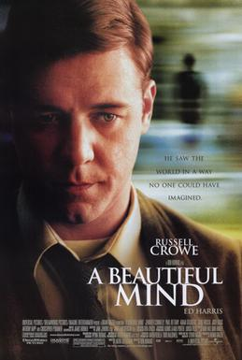
Why a “Nash” equilibrium?

Slide 48

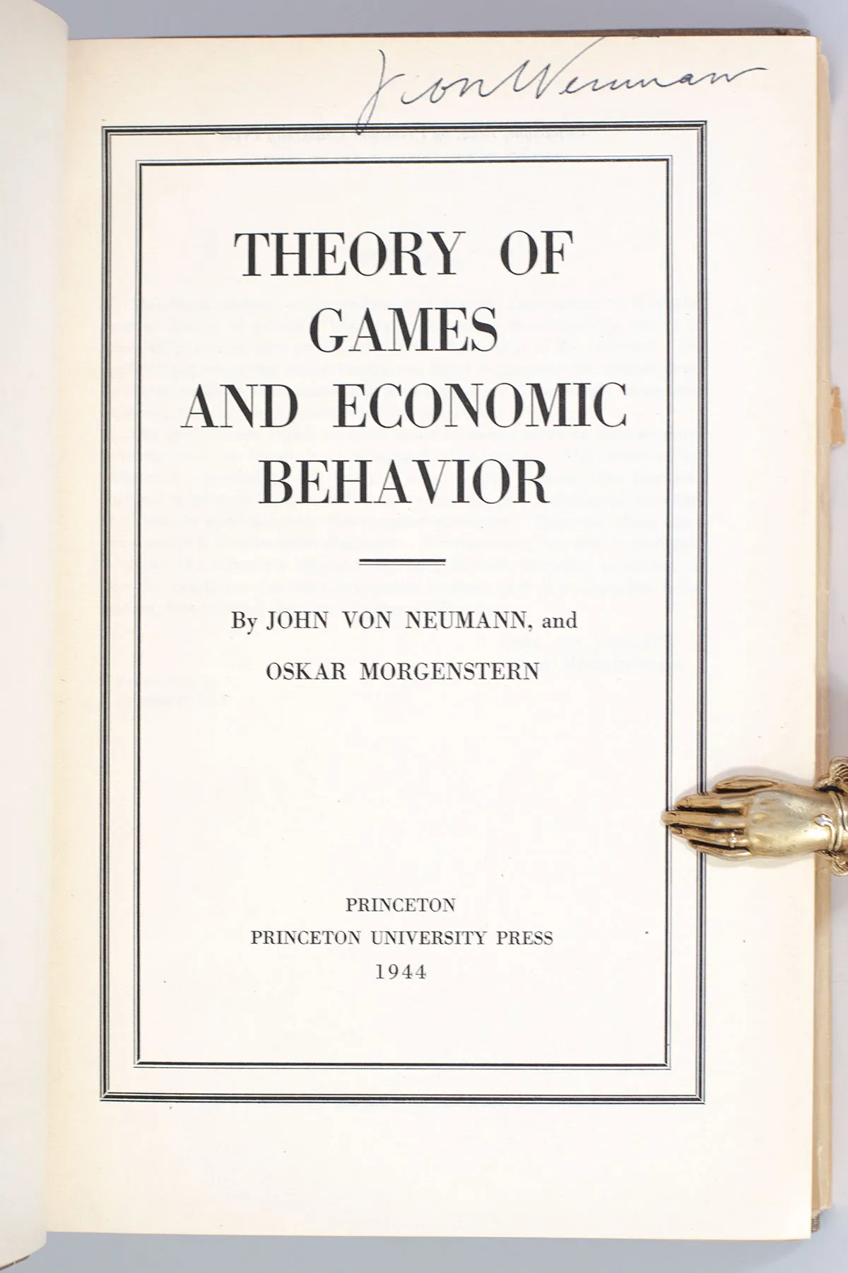
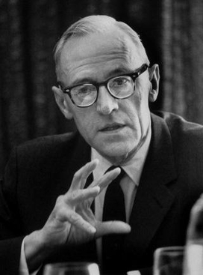
(These guys were important too)
John von Neumann
Oskar Morganstern

Slide 49
Zero sum games
 | Player2
Player1 |  | Rock | Paper | Scissors
 | Rock | Player1 ← 0 Player2 ← 0 | Player1 ← -1 Player2 ← 1 | Player1 ← 1 Player2 ← -1
 | Paper | Player1 ← 1 Player2 ← -1 | Player1 ← 0 Player2 ← 0 | Player1 ← -1 Player2 ← 1
 | Scissors | Player1 ← -1 Player2 ← 1 | Player1 ← 1 Player2 ← -1 | Player1 ← 0 Player2 ← 0
Notes:
Has anyone here hear the term “Zero sum game”? It’s a commonly used expression, even outside of game theory. Has leaked into the general public. But what does it mean?
Literally, it means that for each possible outcome, the sum of utilities is equal to zero. Literally, a zero sum game
But what is the plain english interpretation of this?

Slide 50
Negative sum games
 | Prisoner 2
Prisoner 1 |  | Cooperate | Defect
 | Cooperate | Player1 ← -1 Player2 ← -1 | Player1 ← -3 Player2 ← 0
 | Defect | Player1 ← 0 Player2 ← -3 | Player1 ← -2 Player2 ← -2
Notes:
In a negative sum game, the utility sums to a negative number. Collectively the players are worse off by having had played this game

Slide 51
Positive sum games?

Slide 52
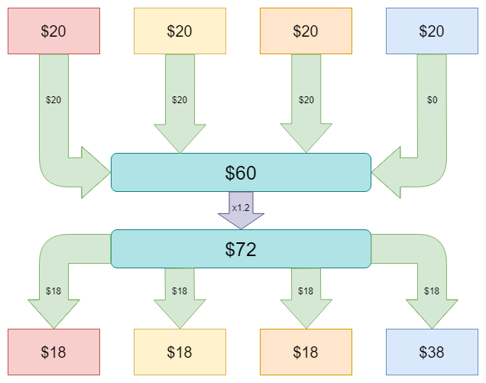
The Public Goods game (a positive sum game)
Notes:
Someone remind me what a public good is? (Non-rivalrous and non-excludable)
The public goods game supposes that individuals can invest in some public good, say, a public park. It’s going to cost each player some money. Let’s say each player commits to contributing $20 to the park, and that the value of the public good they are creating will be 1.2x the investment
But wait! The blue player played the defect strategy! They did not actually contribute anything to the public park!
Only $60 goes into the pot
Multiplied by the 1.2x factor and the public park provides $72 to the community, which is spread evenly among the players, i.e. 72 / 4 = $18 of benefit for each player
Recall that it’s a public good! Non-excludable! No one can stop the blue player from enjoying the park.

Slide 53
The Public Goods game (a positive sum game)
-$2
-$2
-$2
+$18
Notes:
The red, yellow, and orange players started with $20 and ended up with $18. They are worse off than when they started
The blue player defected and contributed nothing but still gets to enjoy their $18 worth of the park. They started with $20 and ended up with $38
If you were to ignore things like civic duties or ethics or the IRS, what is the rational strategy? Defect! Don’t contribute anything and hope that you can free ride off of the contributions of others.

Slide 54
The Public Goods game (a positive sum game)
∑ = +$12
-$2
-$2
-$2
+$18
Notes:
It’s a positive sum if anyone at all invests in the public good. Otherwise, if everyone defects, it’s a zero-sum game (a zero-everything game—no utility changes h

Slide 55
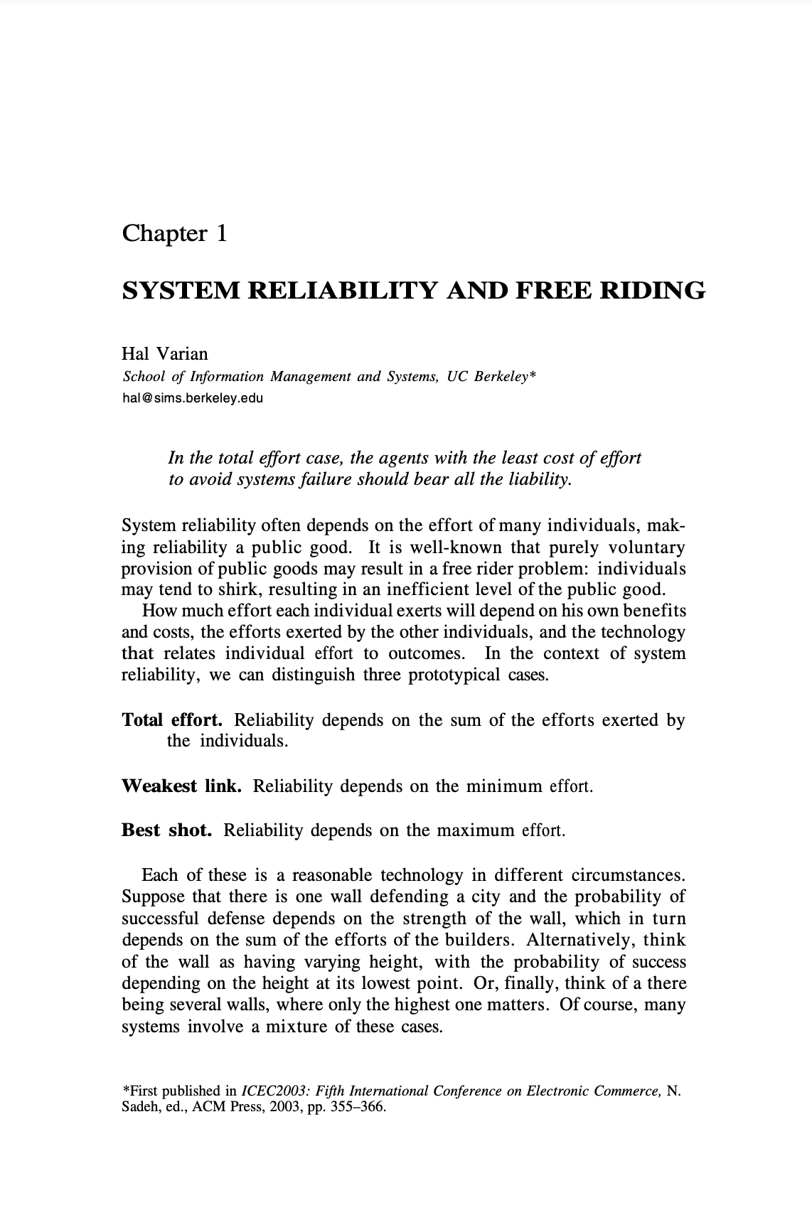
Notes:
There are many, many more games we can analyze, often with a catchy or quirky title (like the Stag and Hare game, Battle of the Sexes, Diner’s dilemma, the pirate game), each with their own interesting properties and outcomes. We could spend all class discussing these. But we should talk about the papers themselves

Slide 56
But first: a (non-game theory) game
I want to know how easy or difficult these readings were for you
However, if I ask each of you directly, you might not answer truthfully
There might be an incentive to overstate your comprehension
What can we do?
Write down your answer on a sheet of paper?
Handwriting is easily de-anonymized
Anonymous online survey?
Maybe, but have to trust the survey host not to collect IPs or de-anonymize another way
Secret ballot voting?
Requires physical ballots, ballot box, secret room
We are a virtual class today

Slide 57
An incentive compatible mechanism for eliciting truthful responses
I will send one of you a secret number via chat
If you thought the readings were easy, add 1 to the number
If you thought the readings were hard, subtract 1 from the number
Pass the new number to the next person in the chain.
Adam → Gabe → Ina → Madhura → Nashita → Noam → Neha → Adam
Advantages:
If the final number is greater than the starting number, I know the class overall found the readings to be easy
If the final number is less than the starting number, I know the class overall found the readings to be hard
No one is able to infer the responses of anyone else
Notes:
What are the disadvantages?
Requires some trust. If you wanted to swing the score, you could subtract 5 instead of 1. Might not be detectable (although if final number is 100 less than starting, I would know!)
O(n). Fine for a class of 6, but not for voting on the president (200M voters)

Slide 58
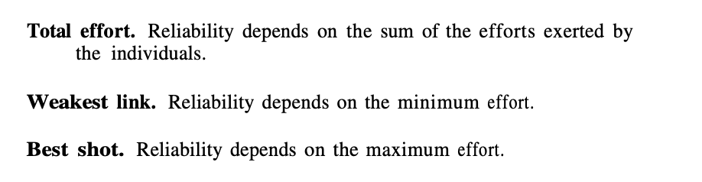
Notes:
What do we think about these assumptions? Hal Varian evaluates all three types of games. Is this useful? Is he failing to draw a line in the sand and say exactly which of these three games best matches the “game” of reliability?
“Each of these is a reasonable technology in different circumstances. Suppose that there is one wall defending a city and the probability of successful defense depends on the strength of the wall, which in turn depends on the sum of the efforts of the builders. Alternatively, think of the wall as having varying height, with the probability of success depending on the height at its lowest point. Or, finally, think of a there being several walls, where only the highest one matters. Of course, many systems involve a mixture of these cases.”

Slide 59
security
security
security
Notes:
The paper is about reliability but these three games can be seen as having identical analogues in security.
It’s not hard to think of scenarios where each of these are security games instead of reliability games
What’s an example of a “best shot” game in security? Systems with high redundancy—e.g. You want to take down a website that’s hosted in multiple places; if you want to take it down completely you have to take down the most secure version
What’s an example of a “weakest link” game? Spam. You only need to compromise the weakest node on a network to start sending out spam to all the better-secured nodes
What’s an example of a total effort game? Maybe blockchain and 51% attacks. What’s a 51% attack? (blockchains based on consensus; if you control 51% of nodes you can manufacture whatever consensus you want)

Slide 60
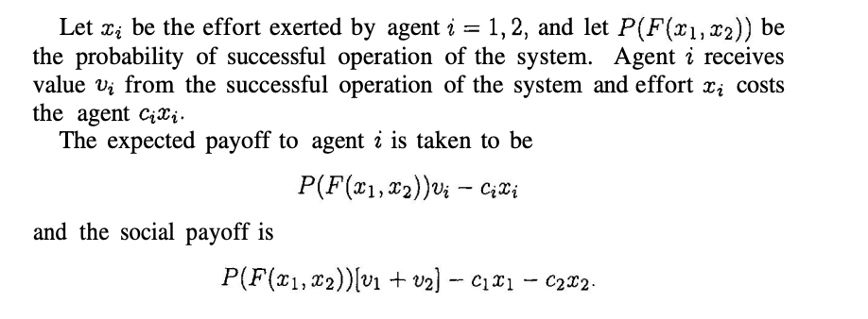
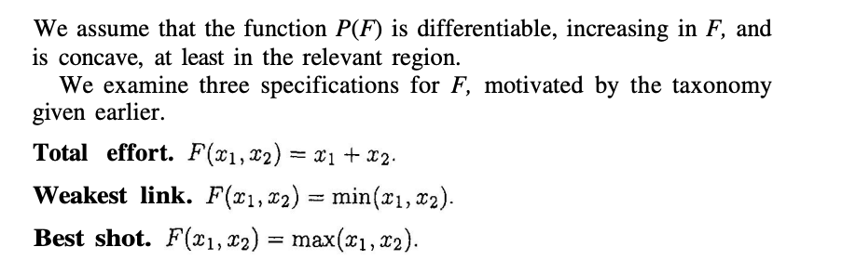
Notes:
Why have effort and cost be separate things?
Intuitively, cost and effort are not the same thing.
But for a simple model, they are very close.
We’ll see. Maybe it’s explained later.
Is this a reasonable simplification of the system of various players that have to work together to ensure system reliability or security?

Slide 61
?
Notes:
More investment = higher probability of successful operation. Reasonable? Yeah I think so.

Slide 62
?
Notes:
Diminishing returns on investment

Slide 63
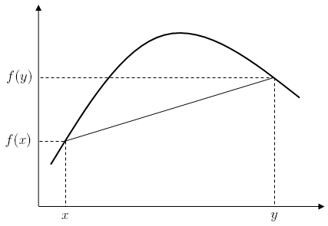
?
Notes:
Diminishing returns on investment

Slide 64
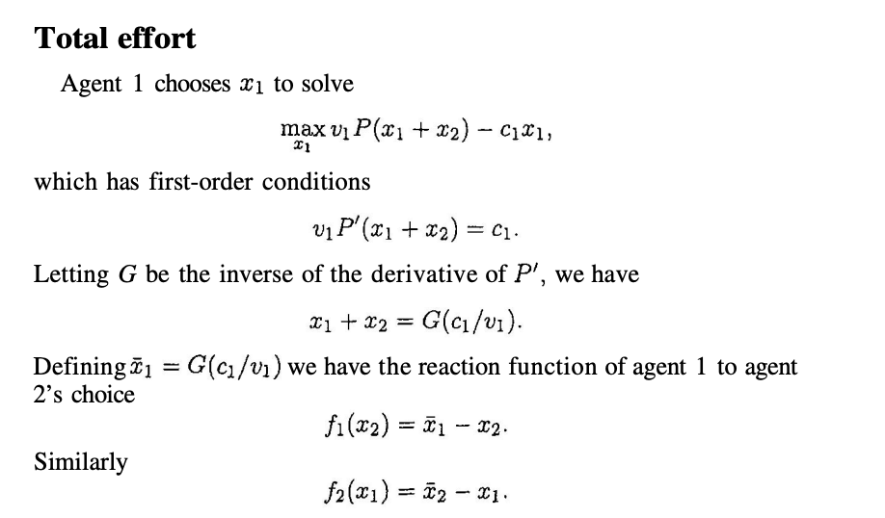

Slide 65
?

Slide 66
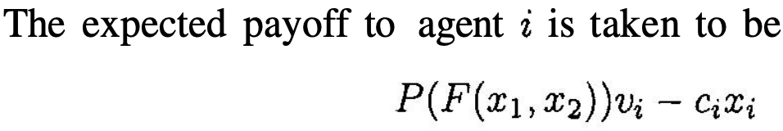
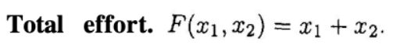
?
Notes:
Agent 1 wants to know what the maximum payoff can be

Slide 67
?
Notes:
Agent 1 wants to know what the maximum payoff can be

Slide 68
Find where d/dx = 0
Because P(F) is concave, we know this is a maximum
?
Notes:
Agent 1 wants to know what the maximum payoff can be

Slide 69
Notes:
Basic algebra

Slide 70
?
Notes:
Basic algebra

Slide 71
If Agent 2 spends x₂, then Agent 1’s personal welfare is maximized when Agent1 spends \bar{x}_1 - x_2
Notes:
Basic algebra

Slide 72
If Agent 1 spends x₁, then Agent 2’s personal welfare is maximized when Agent 2 spends \bar{x}_2 - x_1
Notes:
Basic algebra

Slide 73
If Agent 1 spends x₁, then Agent 2’s personal welfare is maximized when Agent 2 spends \bar{x}_2 - x_1
Aka “Best response”
Notes:
Basic algebra

Slide 74
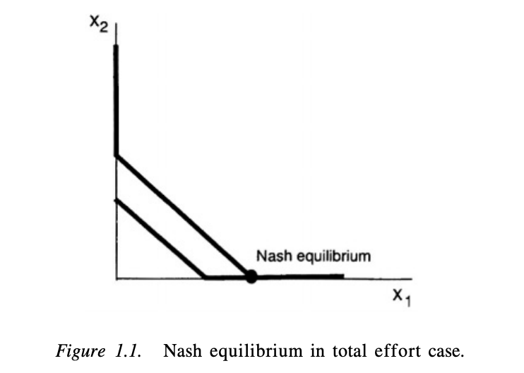
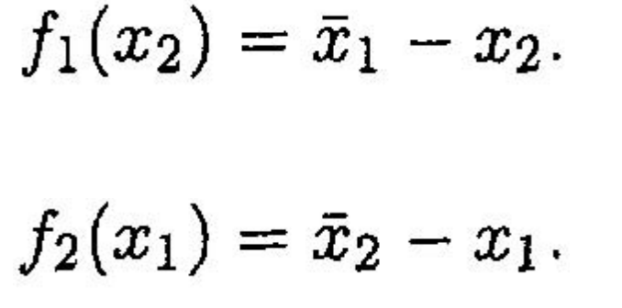
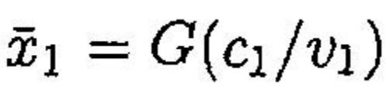
Notes:
What is the shape of G(c1/v1)?
Recall that G is the inverse of the derivative of P
P is concave down. For example, P could be -x^2.
What is the derivative is -x^2? -2x. It’s a straight line with a negative slope.
If we take the inverse of -2x, i.e. reflect across the x=1 line, we get -½ x. Still a negative slope straight line.
This works if we assume P = -x^2. That’s not written anywhere. There are infinite possible concave functions of P.
But I’d be that if we did some nice math we could prove that these results follow for any P so long as P is concave.

Slide 75
Notes:
There are two lines on this chart. Which one corresponds to f1?

Slide 76
Notes:
f1(x_2) is a function of x2. It represents Agent 1’s optimal investment.
We know it can’t be the blue line because then it wouldn’t be a function! Multiple outputs for same input.

Slide 77
Notes:
Likewise, f2 is agent 2’s optimal investment. It is a function of the other player’s investment x1.
Why do we know that the red line is higher than the blue line?

Slide 78
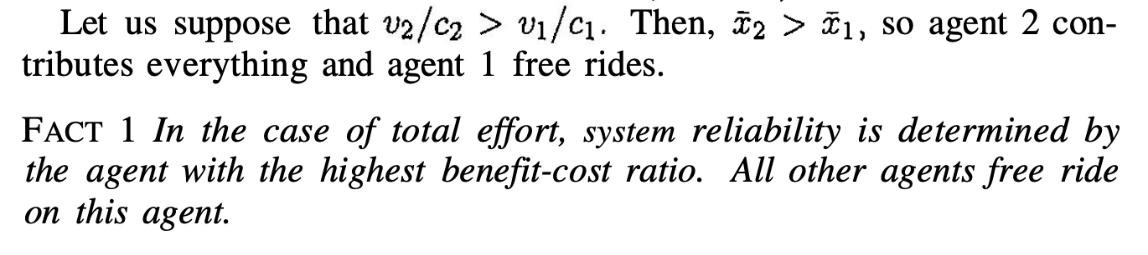
value/cost ratio

Slide 79
value/cost ratio
Agent 2’s value to cost ratio is higher than Agent 1’s

Slide 80
f₁(x₂) > f₂(x₁)

Slide 81
Agent 1 will play somewhere on the red line

Slide 82
Agent 1 will play somewhere on the red line
Agent 2 will play somewhere on the blue line

Slide 83
Agent 1 will play somewhere on the red line
Agent 2 will play somewhere on the blue line
The Nash equilibrium is where the lines intersect

Slide 84
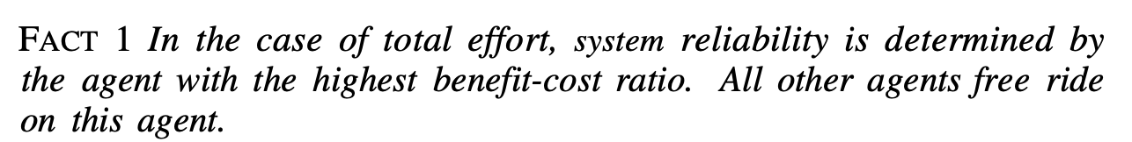
v
Notes:
One player pays everything
The other player plays nothing

Slide 85
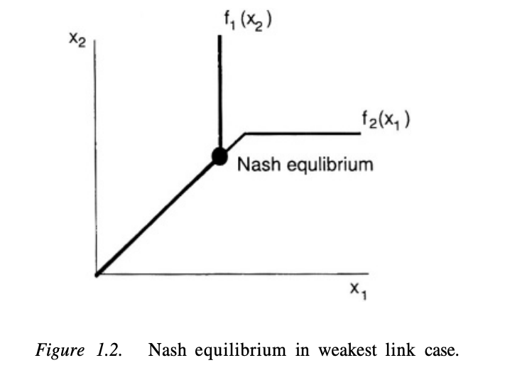
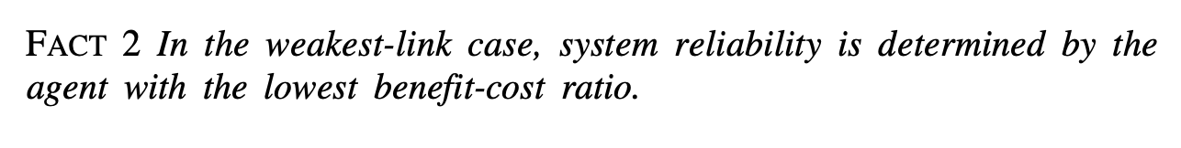
Notes:
“Note that there will be a whole range of Nash equilibria. The largest of these will be at This Nash equilibrium Pareto dominates the others, so it is natural to think of it as the likely outcome.”

Slide 86
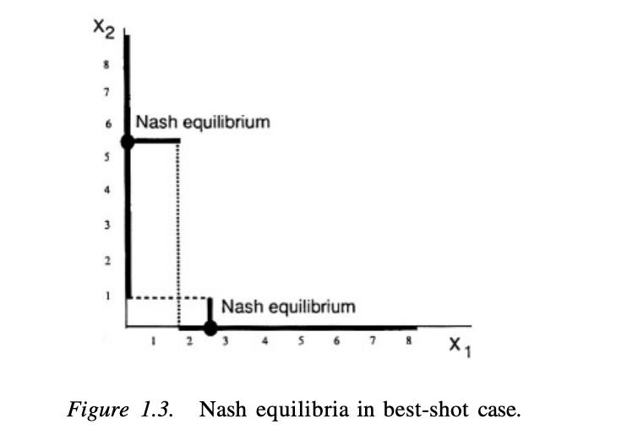
Notes:
Two Nash equilibria! What does this mean?
Stag-hare game.
What if this is a simultaneous game where the players can’t communicate with each other? They might not achieve an equilibrium point. If they can communicate beforehand, they can work out which strategy to play together.

Slide 87
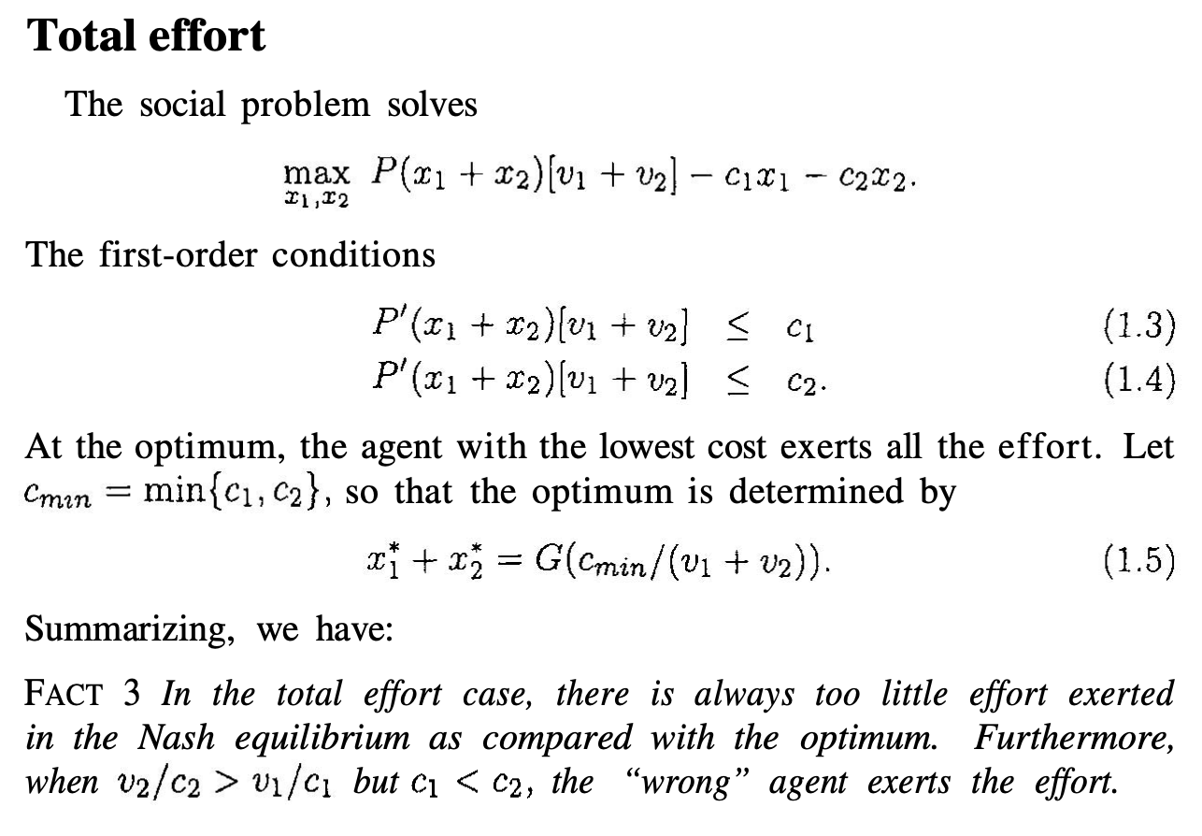
Notes:
Social optima:
What’s the difference between social optima and personal welfare? Social optimum is what’s best for everybody combined, whereas personal welfare is what’s best for you personally.
This Fact #3 is interesting but perhaps not surprising. In the total effort game, the Nash equilibrium does not produce the social optimum. This is typical in many free rider games.
What should we do? Should we force the player who is most capable of shouldering the burden? Should we pass a regulation that requires them to? Should we give them a tax subsidy for doing so? We’ll talk about this later in the semester.
It’s also discussed later in this paper!

Slide 88
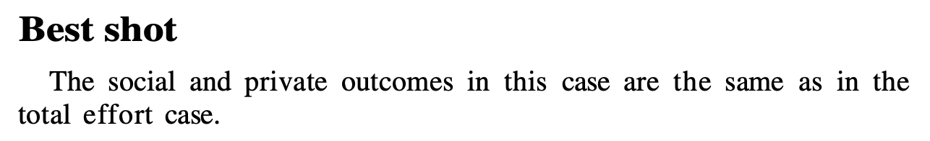

Slide 89
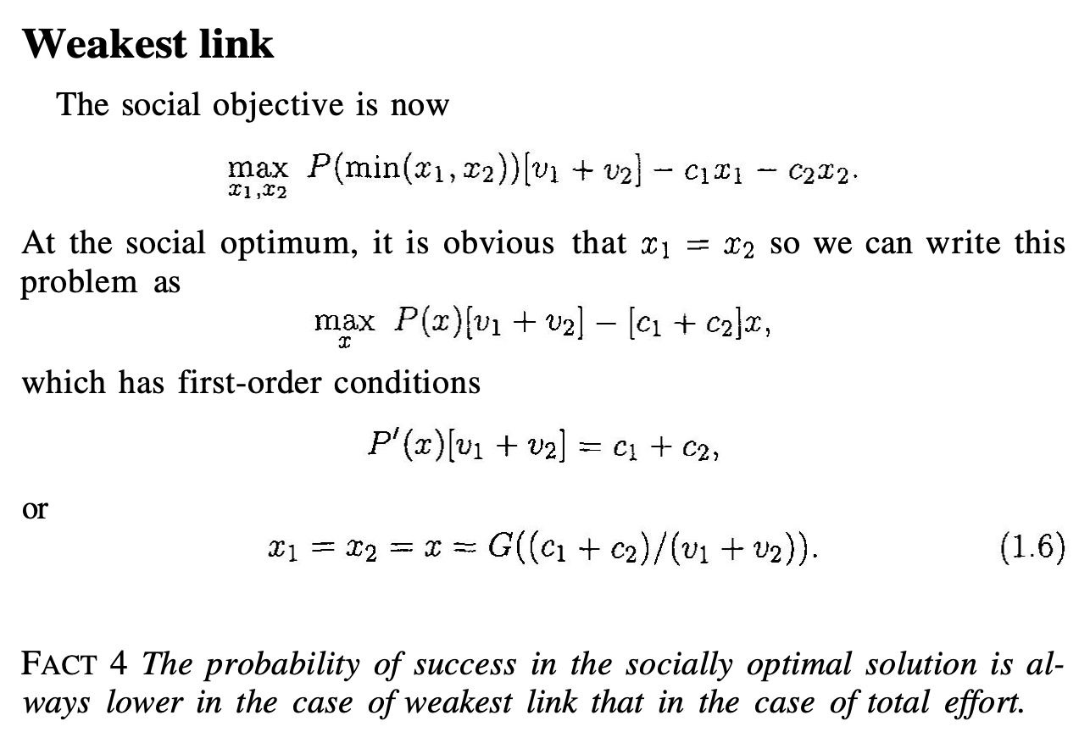
Notes:
I didn’t go through the math to see how this works but it’s not surprising that the probability of success in the socially optimal solution is lower in the case of weakest link than in the case of total effort.

Slide 90
Other situations explored in the paper:
What happens when you add more agents to the game?
Systems become more reliable in total effort game
Systems become less reliable in weakest link game
Can we improve social welfare by imposing fines?
FACT 8 A fine equal to the costs imposed on the other agents should be imposed on the agent who has the lowest cost of reducing the probability of failure.
FACT 9 In the case of weakest link, strict liability is not adequate in general to achieve the socially optimal level of effort, and one must use a negligence rule to induce the optimal effort.
What happens if this a sequential game instead of a simultaneous one?
FACT 10 The equilibrium in the sequential-move, the total-effort game always involves the same or less reliability than the simultaneous-move game.
FACT 11 If you want to ensure the highest level of security in the sequential move game, then you should make sure that the agent with the lower benefit-cost ratio moves first.
What happens if adversaries are introduced?

Slide 91
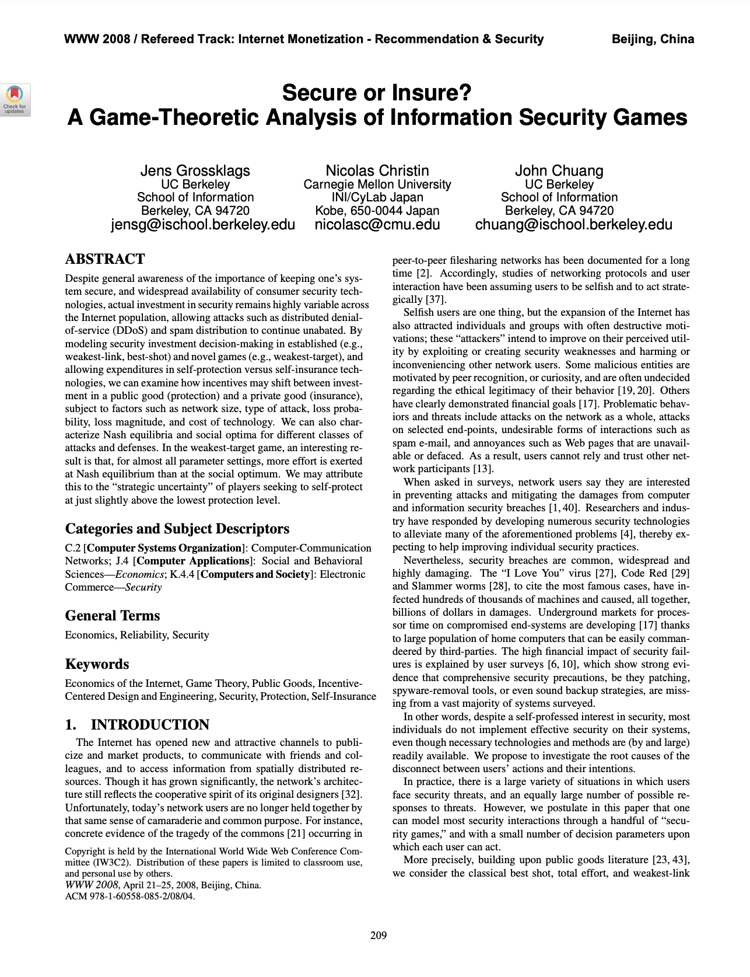
Notes:
A direct successor to the previous paper
Even though this one is clearly more closely related to security, it’s really just a somewhat small adjustment to the previous paper.
Instead of one security variable, they introduce two:
Self protection, and self insurance
Does “insurance” in this case mean buying a cyber insurance policy like we talked about a few weeks ago?
Not necessarily. They keep it vague, but allow it to include things like “having good backups”. It’s an “insurance policy” albeit not a formal one with an insurance company.
In addition to total effort, weakest link, and best shot, they add one additional game. What was it?
Weakest target

Slide 92
What types of games are these?
Game structure: total effort, weakest link, best shot, weakest target
Simultaneous or sequential?
2-player or multiplayer?
Perfect Information or imperfect information?
Deterministic or non-deterministic?
Finite actions or infinite actions?
One-shot or iterated?

Slide 93
Generic utility function:

Slide 94
Generic utility function:
Utility of player i

Slide 95
Generic utility function:
Utility of player i
Initial endowment

Slide 96
Generic utility function:
Utility of player i
Initial endowment
Probability of experiencing a loss

Slide 97
Generic utility function:
Utility of player i
Size of
loss
Initial endowment
Probability of experiencing a loss

Slide 98
Generic utility function:
Utility of player i
Size of
loss
Initial endowment
Insurance level [0,1]
Probability of experiencing a loss

Slide 99
Generic utility function:
Utility of player i
Size of
loss
Initial endowment
Insurance level [0,1]
Probability of experiencing a loss
“Contribution”function

Slide 100
Generic utility function:
Utility of player i
Size of
loss
Security
level [0,1]
Initial endowment
Insurance level [0,1]
Probability of experiencing a loss
“Contribution”function

Slide 101
Generic utility function:
Utility of player i
Size of
loss
Security
level [0,1]
Initial endowment
Insurance level [0,1]
Probability of experiencing a loss
Security levels of all other players
“Contribution”function

Slide 102
Generic utility function:
Utility of player i
Size of
loss
Security
level [0,1]
Initial endowment
Security
unit cost
Insurance level [0,1]
Probability of experiencing a loss
Security levels of all other players
“Contribution”function

Slide 103
Generic utility function:
Utility of player i
Insurance unit cost
Size of
loss
Security
level [0,1]
Initial endowment
Security
unit cost
Insurance level [0,1]
Probability of experiencing a loss
Security levels of all other players
“Contribution”function

Slide 104
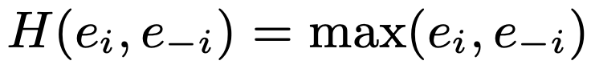
Generic utility function:
Total effort, weakest link, best shot, or weakest target?

Slide 105
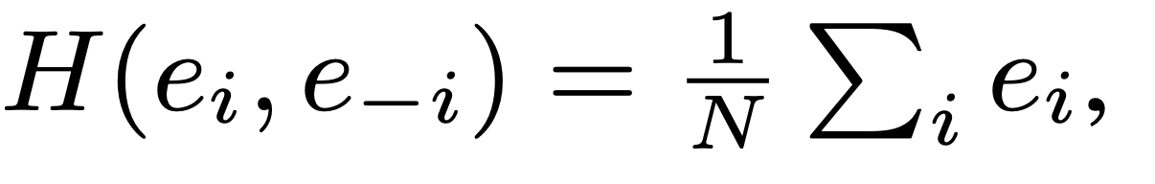
Generic utility function:
Total effort, weakest link, best shot, or weakest target?

Slide 106
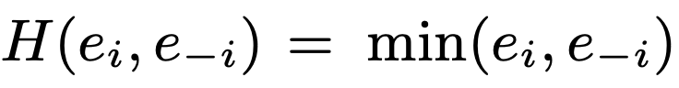
Generic utility function:
Total effort, weakest link, best shot, or weakest target?

Slide 107
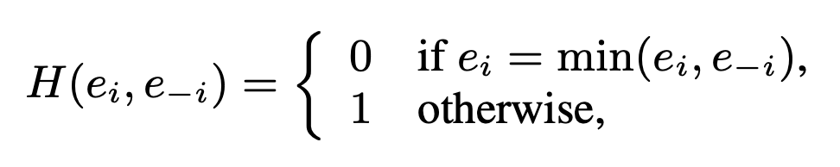
Generic utility function:
Total effort, weakest link, best shot, or weakest target?
Notes:
What is the intuition here?
From the Utility function, do players want H to return a big value or a small value?
If H(ei, e-i) returns 1, then 1 - H = 0 and the expected loss to attackers is 0.
I.e. players want H to be 1
This game is formalizing the idea that the attackers will always go after the weakest target. Reasonable assumption? (I think so)
Anyone have any questions on the construction of the utility functions or the various contribution functions?

Slide 108
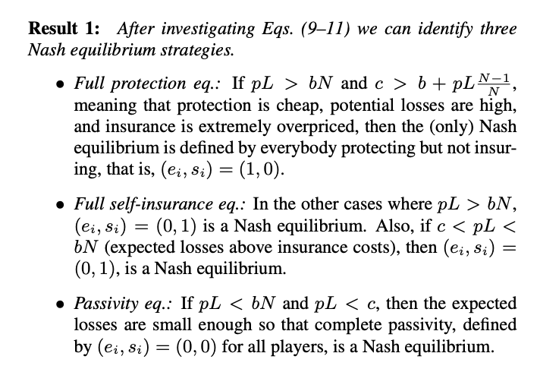
Nash equilibrium analysis: Total Effort
Notes:
I’m going to skip over the calculus of it all and assume that we could all figure it out if given the time
I’m actually not so interested in the results because they generally are of this form: if this variable times this variable is greater than this expression, then xyz etc.
Maybe useful if I have, say, a problem that perfectly matches the Total Effort game, and I know what the parameters are.
I think the interesting this is looking at how they constructed the problem more than what their statement of the problem reveals. You may disagree.

Slide 109
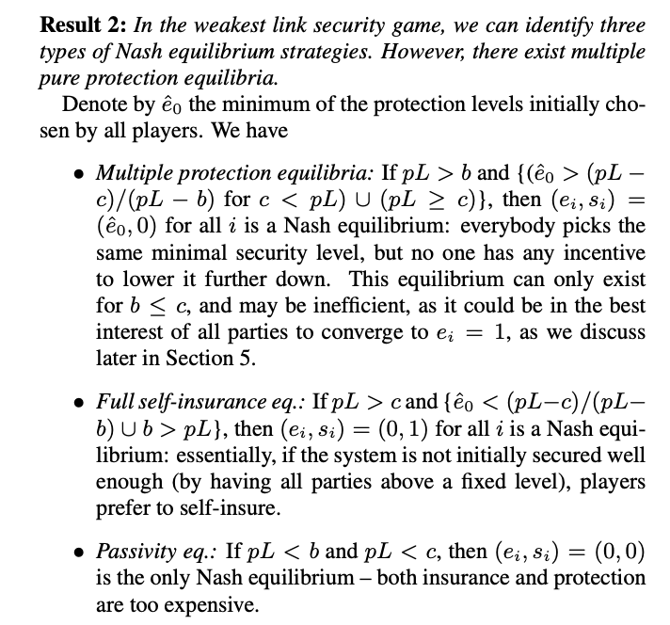
Nash equilibrium analysis: Weakest Link
Notes:
I’m going to skip over the calculus of it all and assume that we could all figure it out if given the time

Slide 110
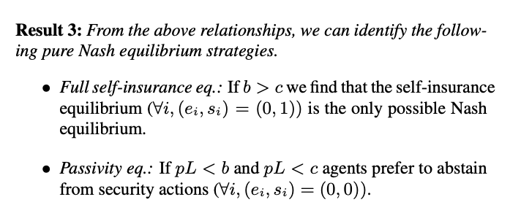
Nash equilibrium analysis: Best Shot
Notes:
I’m going to skip over the calculus of it all and assume that we could all figure it out if given the time

Slide 111
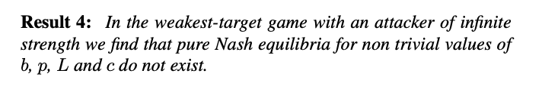
Nash equilibrium analysis: Weakest Target
Notes:
I’m going to skip over the calculus of it all and assume that we could all figure it out if given the time

Slide 112
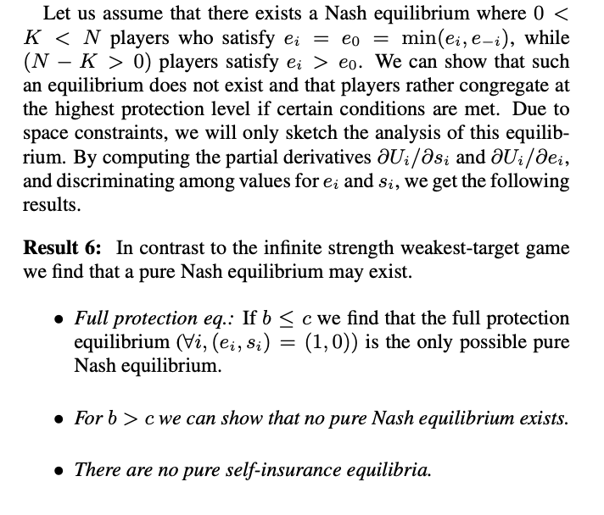
Nash equilibrium analysis: Weakest Target (with mitigation)
Notes:
I’m going to skip over the calculus of it all and assume that we could all figure it out if given the time

Slide 113
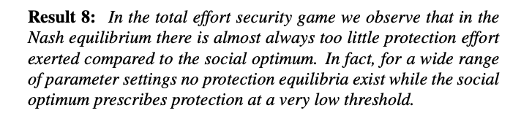
Social optima analysis: Total Effort
Notes:
This follows from the Hal Varian paper

Slide 114
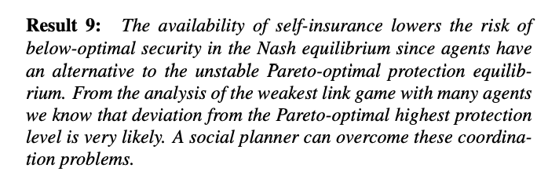
Social optima analysis: Weakest Link
Notes:
This follows from the Hal Varian paper

Slide 115
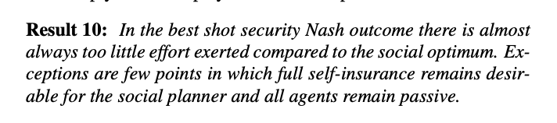
Social optima analysis: Best Shot
Notes:
This follows from the Hal Varian paper

Slide 116
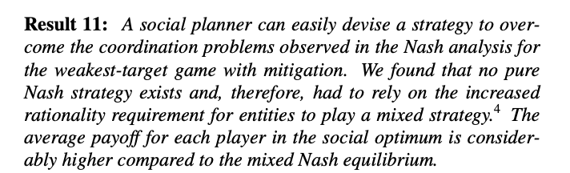
Social optima analysis: Weakest Target
Notes:
This follows from the Hal Varian paper

Slide 117
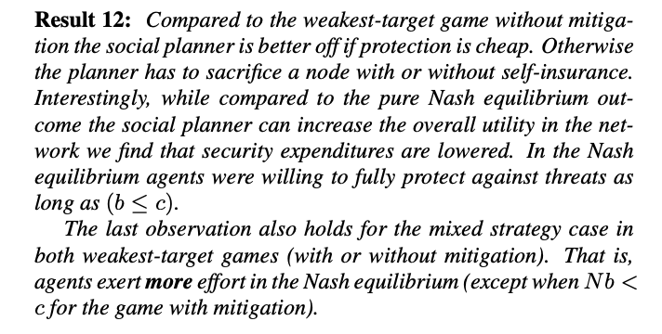
Social optima analysis: Weakest Target (with mitigation)
Notes:
This follows from the Hal Varian paper

Slide 118
What is the value of analyzing security games this way?
Does this actually help anyone? Why or why not?
I don’t think I’ve ever heard or seen this type of game theory ever discussed among real-world security practitioners. Why?

Slide 119
What is the value of analyzing security games this way?
Does this actually help anyone? Why or why not?
I don’t think I’ve ever heard or seen this type of game theory ever discussed among real-world security practitioners. Why?
Are the models too simple? (e.g. linear costs of protection)
Do we not know how to estimate variables (like “unit cost of insurance”)
Other strong assumptions?
Is game theory beyond the abilities of most security practitioners?
Remember Gordon-Loeb model?

Slide 120
Cybersecurity and Game Theory
COMS6998 sec:12 | The Economics of Cybersecurity
March 26, 2024

